Slide 1
Detection of Cyberbullying in Social Media
Texts using Explainable Artificial Intelligence (XAI)
Team: 02
Name: Tamanna Sultana Tonu
ID: 19101155
ST: Abid Hossain
RA: Sania AZhmee Bhuiyan
Course: CSE424

Slide 2
Introduction
Text justification through three NLP tools
Text Preprocessing
Sentiment Analysis
Term Frequency-Inverse Document Frequency (TF-IDF)
Explainable Artificial Intelligence (XAI)
Local Interpretable Model Agnostic Explanation (LIME)

Slide 3
Related Works
Limited to a binary classification of text as cyberbullying or non-cyberbullying
Unable to determine specific types of cyberbullying
Relying on black-box machine learning models

Slide 4
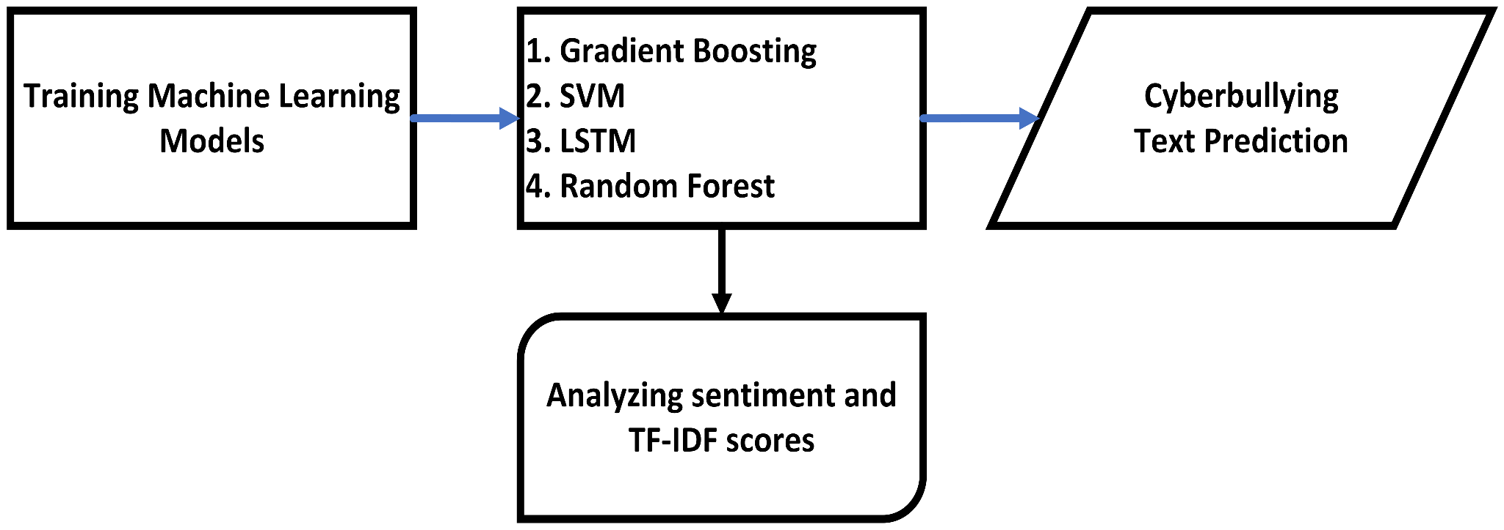
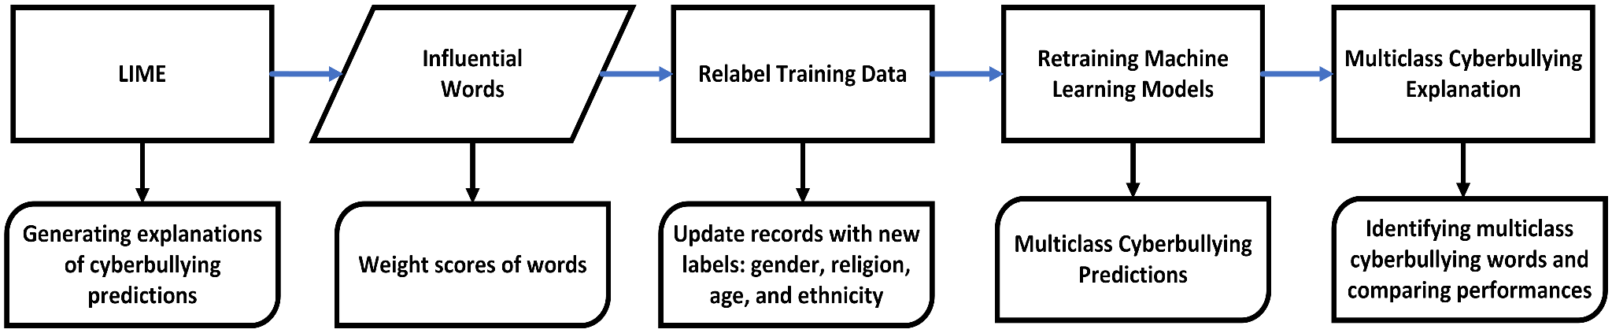
Methodology
Dataset
Text Pre-processing Layer
Text Training Layer
Decision Explanation Layer
Figure: Text Training Layer
Figure: Decision Explanation Layer

Slide 5
Results
The use of LIME demonstrates that these machine learning models provide similar justifications for their decision-making processes
LIME explanations for a certain model are trustworthy

Slide 6
Conclusion
LIME algorithm is a valuable tool in Explainable AI (XAI), provides local, interpretable explanations for individual predictions by approximating the behavior of black-box models. LIME is model-agnostic, making it widely applicable, but it has limitations in capturing complex interactions and global patterns. Nonetheless, LIME helps build trust and understanding in complex AI systems, especially in high-stakes domains.
Reference: https://qspace.library.queensu.ca/bitstream/handle/1974/31678/Islam_MohammadRafsun_202305_MSC.pdf?sequence=3

